Slide 1
Creative Workshop
Workshop Made Simple

Slide 2
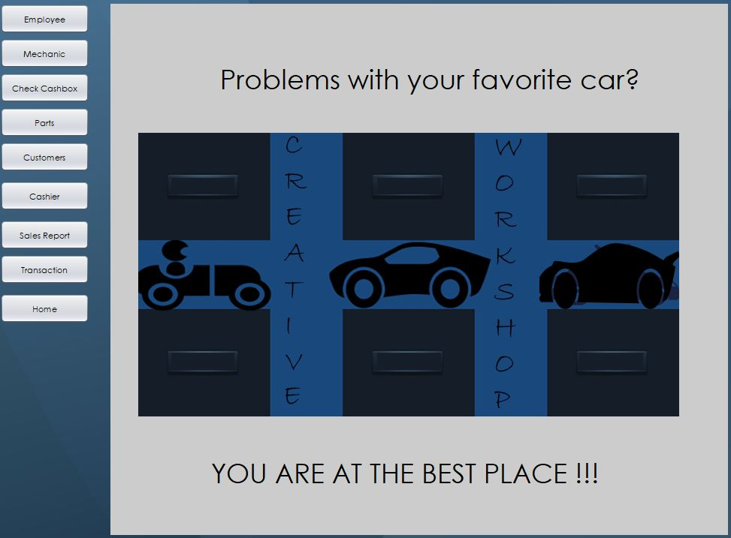
Home Screen

Slide 3
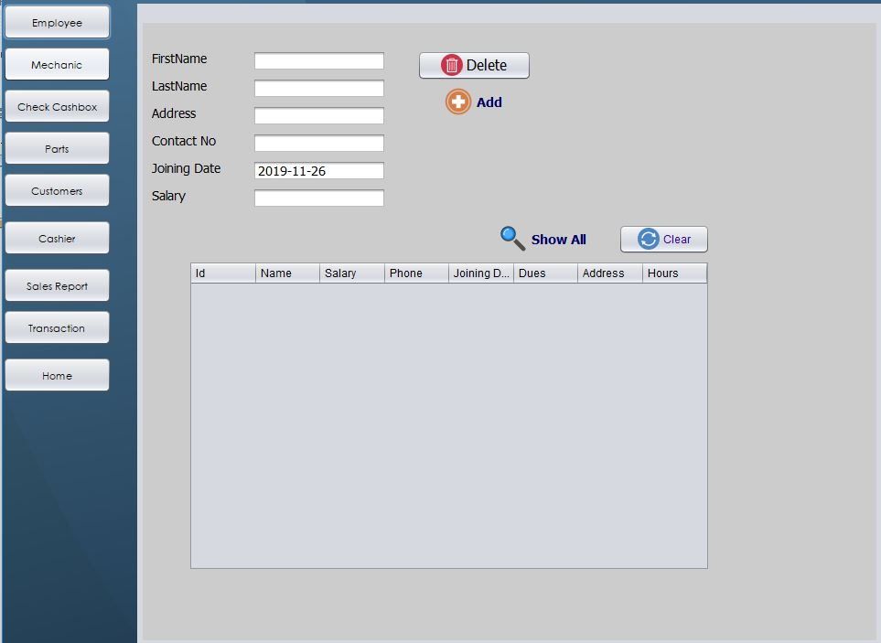
Employee Screen

Slide 4
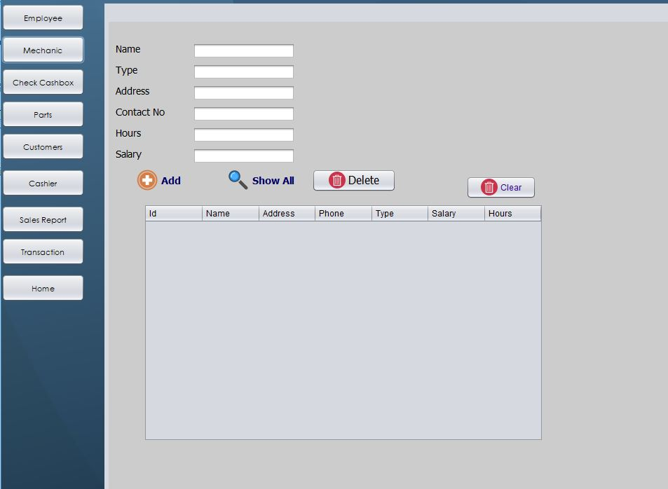
Mechanic Screen

Slide 5
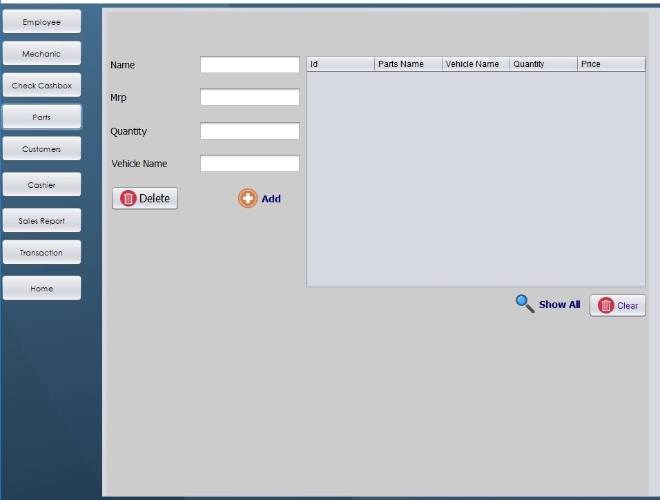
Parts Inventory

Slide 6
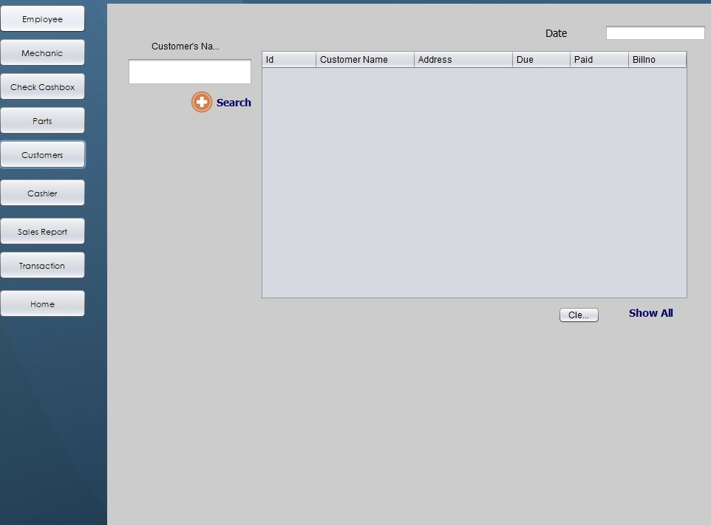
Customer Screen

Slide 7
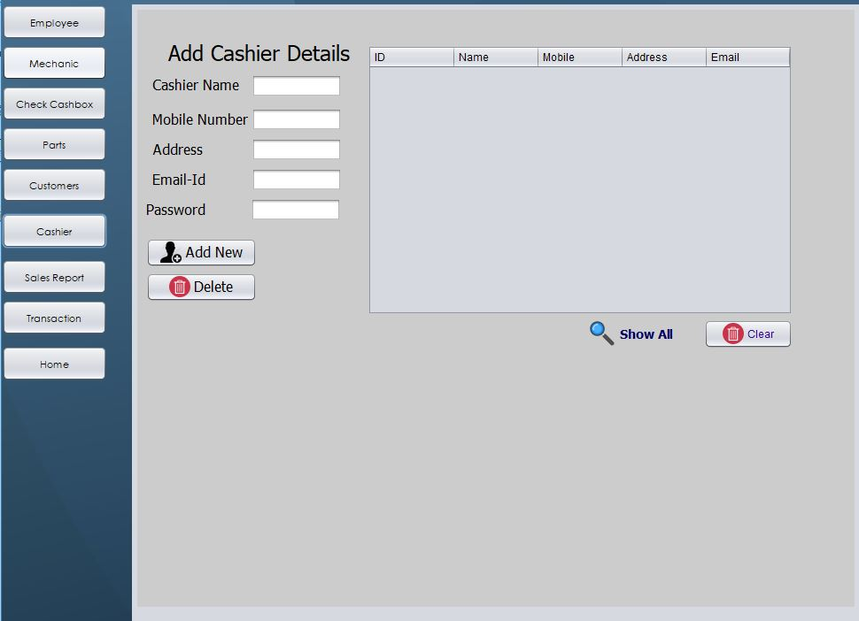
Cashier Screen

Slide 8
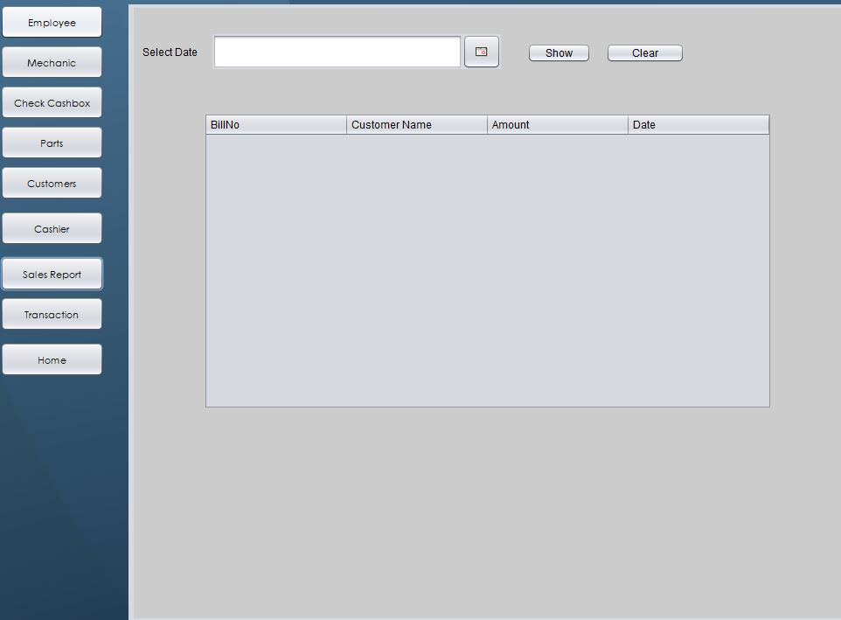
Sales Report

Slide 9
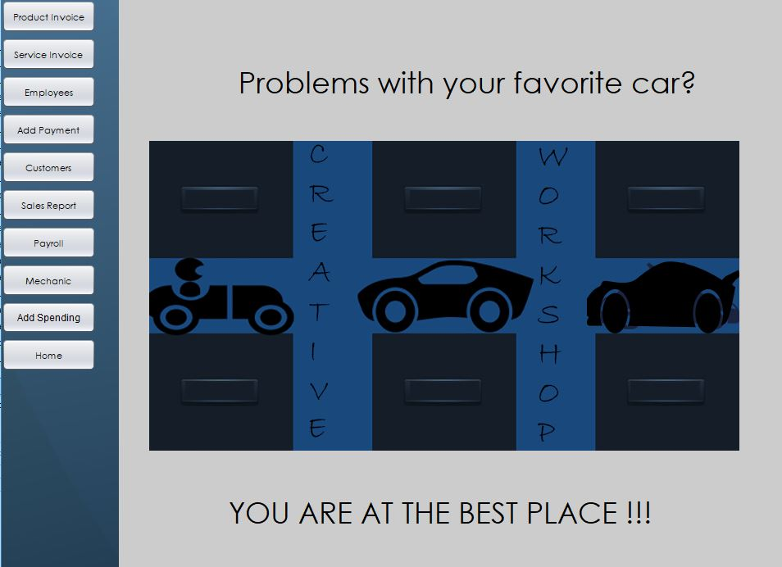
Screen For Admin

Slide 10
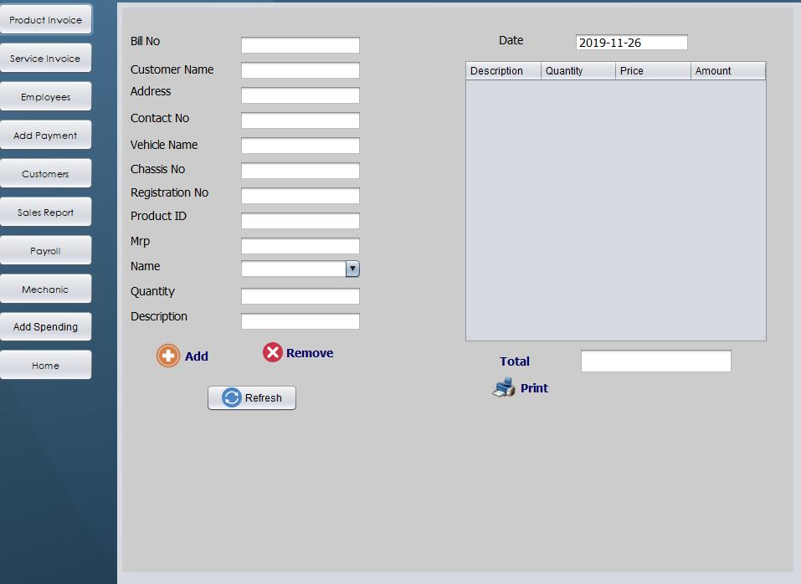
Product Invoice

Slide 11
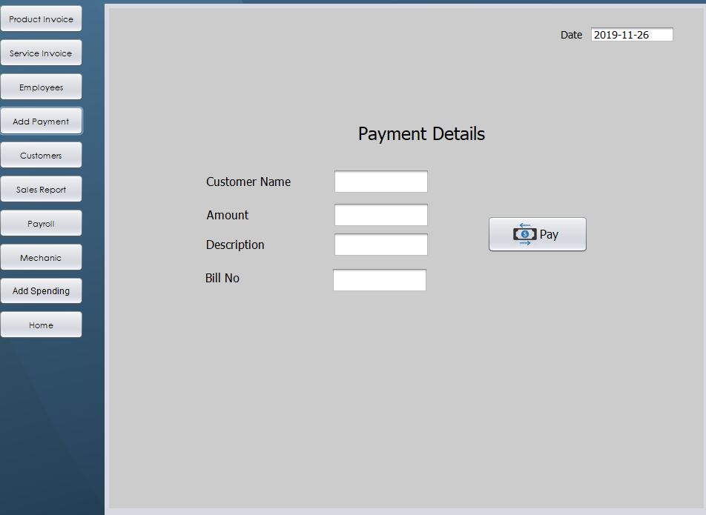
Payment Screen

Slide 12
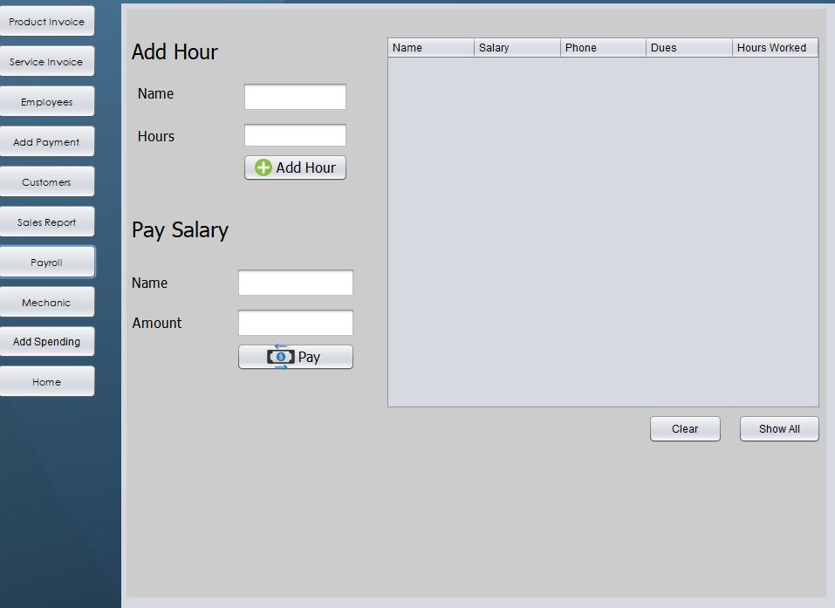
Employee Workhour

Slide 13
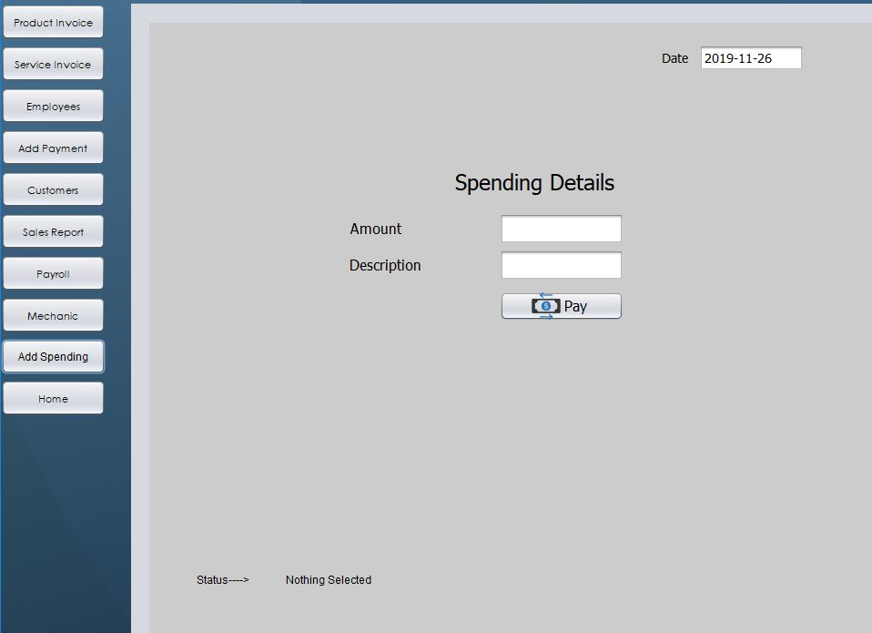
Transaction (Expenditure)

